Slide 1
Evidence of the Theory of Evolution
Darwin’s Theory of Evolution
Geological Time Scale
Evidence of Evolution
  Fossil
Examples of the Evidence of Evolution
  Classic examples (Transitional fossil – Archaeopteryx and Transitional forms in the horse fossil record)

Slide 2
Evolution
Mutation
Non-random changes to allele frequency of population
Random changes to allele frequency of population
Variation in Gene Pool
Variation in Populations
Natural Selection
Sexual Selection
Artificial Selection (Selective breeding)
Genetic Drift
Bottleneck Effect
Founder Effect
Mechanisms of Evolution
Microevolution
Gene Flow

Slide 3
Evolution
1. Mutation
2. Natural Selection
3. Genetic Drift
Mechanisms of Evolution
4. Gene Flow
Microevolution
Long time period (many generations)
Speciation
Macroevolution

Slide 4
Syllabus:
Life has existed on Earth for approximately 3.5 billion years and has changed and diversified over time
State how long life has existed on Earth and how it has changed and diversified over time
What is the ‘theory of evolution’?
Heredity
Essential
Question:
BIOLOGY WA UNITS 3&4
Chapter 8 Mechanisms of Evolution and Speciation pg. 310 – 316
Questions
Set 8.1 pg.250 Q 1-5 – Terminology & the Theory of Evolution
Set 8.2 pg.254 Q 1-4 - Biogeography
BIOZONE Activity Number:
223 – Descent and Common Ancestry

Slide 5
Topic Question 1: Define the following terms, evolution, ancestor, common ancestor & theory
Term | Definition
 | is the process of cumulative, heritable change in a population over many generations.
 | is a species from which other species have evolved
 | refers to an ancestor that is shared by different species. This is supported by molecular evidence: there is a common genetic code in the form of DNA and RNA.
 | is an explanation that has not been proven as fact using Scientific Method but is supported by evidence.

Slide 6
Evolution is the __________________________in genetic makeup of a population in successive generations over time
______________________ within a species including variation in their phenotype & genotype. Some variations offer an advantage
As a result of _________________________these favoured traits are selected for
Gradually over many generations there will be a _______________________________ in the population with an increase in the frequency of the favoured alleles/traits
Topic Question 2:
What does Darwin’s Theory of Evolution state?
Topic Question 3:
Why is the ‘theory of evolution’ a ‘theory’

Slide 7
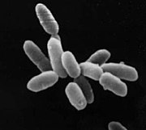
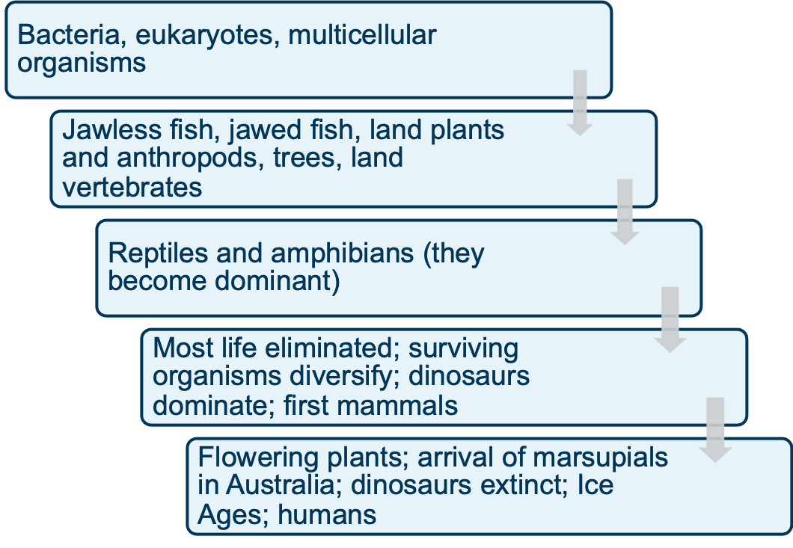
Topic Question 4:
How long has life existed on Earth?
Topic Question 5:
How has life on Earth changed and diversified on Earth?

Slide 8
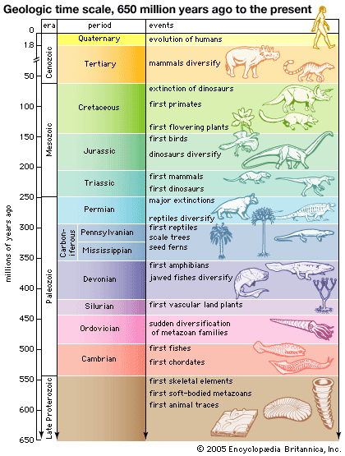
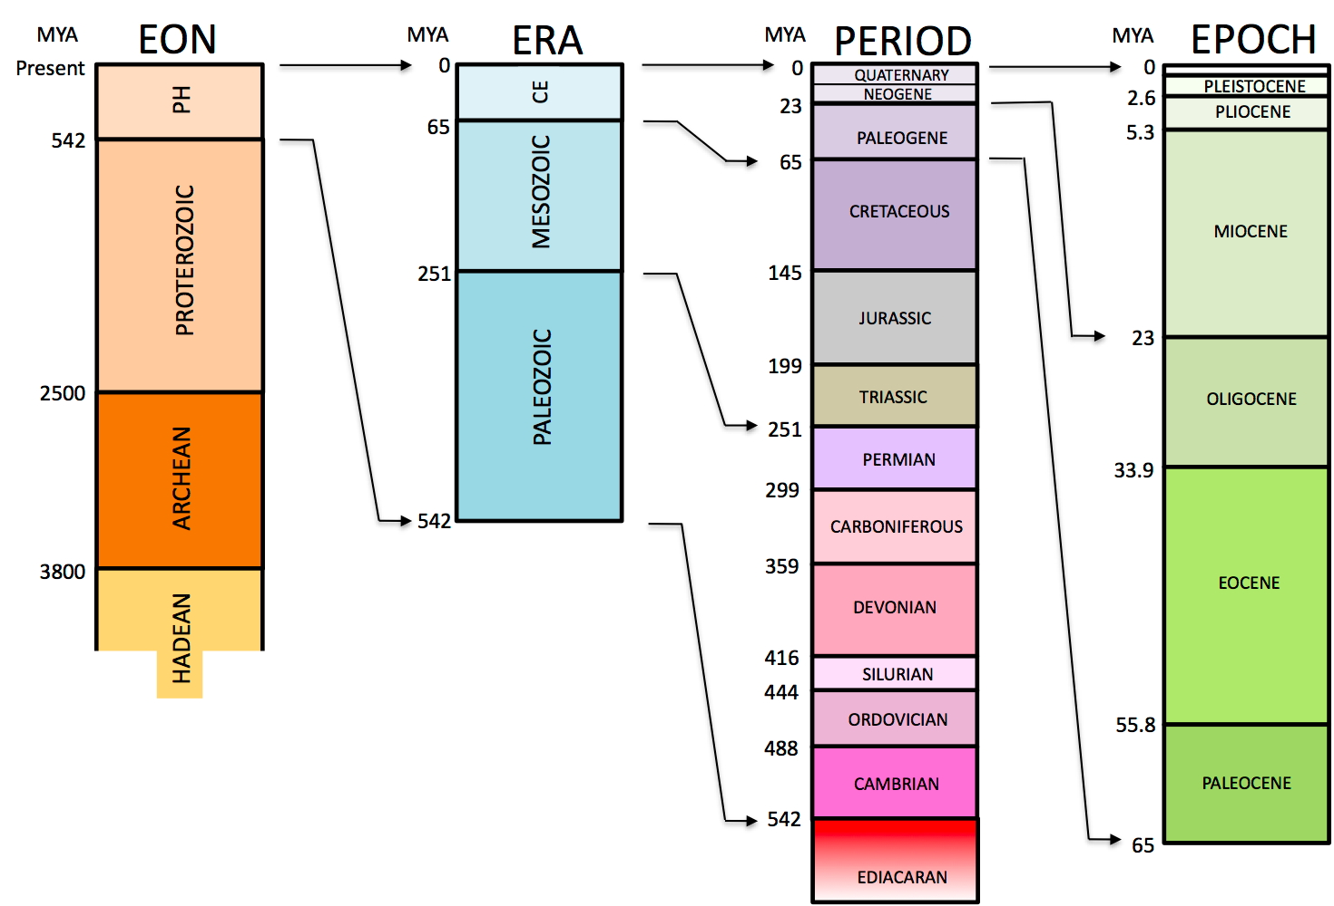
Topic Question 6: What is the geological time scale and what changes on earth have occurred during this time?
What is the Geologic Time Scale?

Slide 9
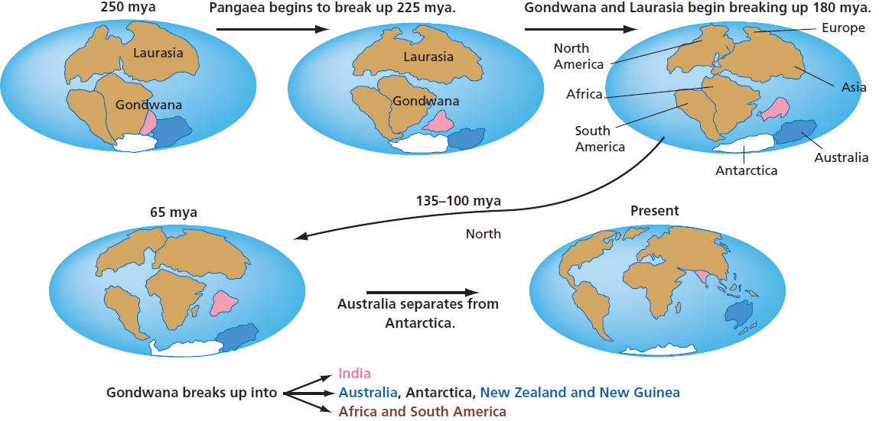
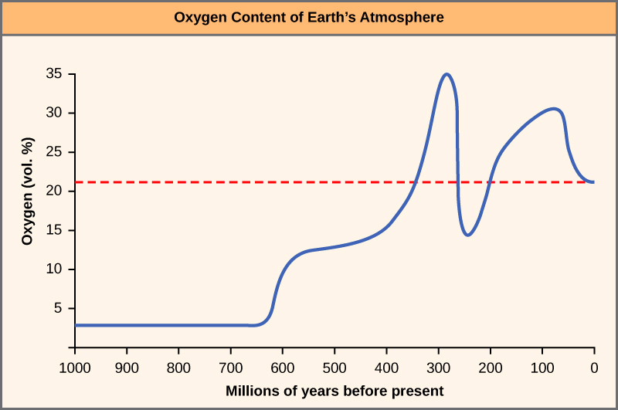
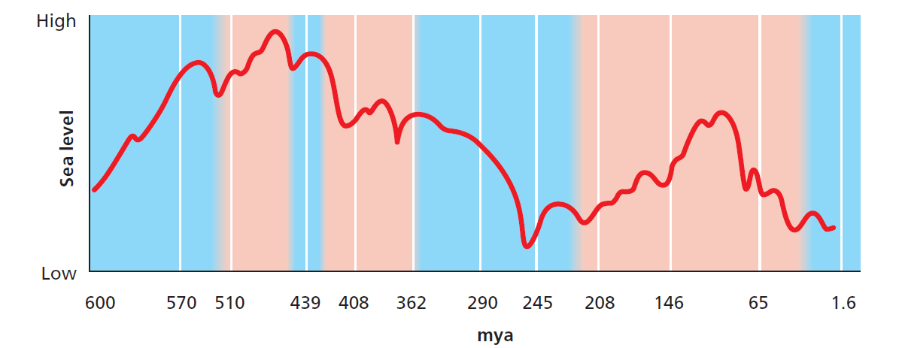
Topic Question 6: What is the geological time scale and what changes on earth have occurred during this time?
What changes have occurred?

Slide 10
Syllabus:
Evidence for the theory of evolution includes: comparative genomics (molecular evidence), the fossil record, comparative anatomy and embryology
Using examples describe the different types of evidence used to support the theory of evolution
Heredity
Essential
Question:
BIOLOGY WA UNITS 3&4
Read
Chapter 8 Mechanisms of Evolution and Speciation pg. 262 - 268
Questions
Set 8.4 pg.268 Q 1-7
BIOZONE Activity Number:
230

Slide 11
5 Lines of Study | Evidence for Evolution
 | the study of prehistoric life, particularly the fossil record
 | the study of the distribution of species over time
 | the study of the process by which organs develop
 | the study of the form and structure of organisms
 | the study of genes, heredity and variation in living organisms
Topic Question 1:
State the 5 lines of study that has provided the evidence to support the theory of evolution
Fossil evidence
Comparative Anatomy
Comparative Embryology
Comparative genomics – the comparison of genomic features of organisms
Comparative biochemistry – the comparison of proteins of organisms
Bioinformatics – analysis of large data sets (such as the genomic sequences of different organisms)
Topic Question 2:
State the evidence used to support the ‘Theory of Evolution’

Slide 12
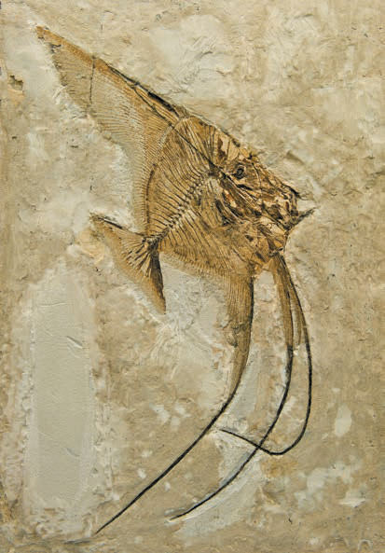
Topic Question 3:
Define the term fossil
Topic Question 4:
What evidence of evolution do fossils provide?

Slide 13
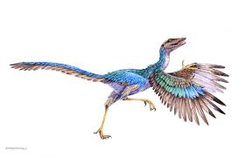
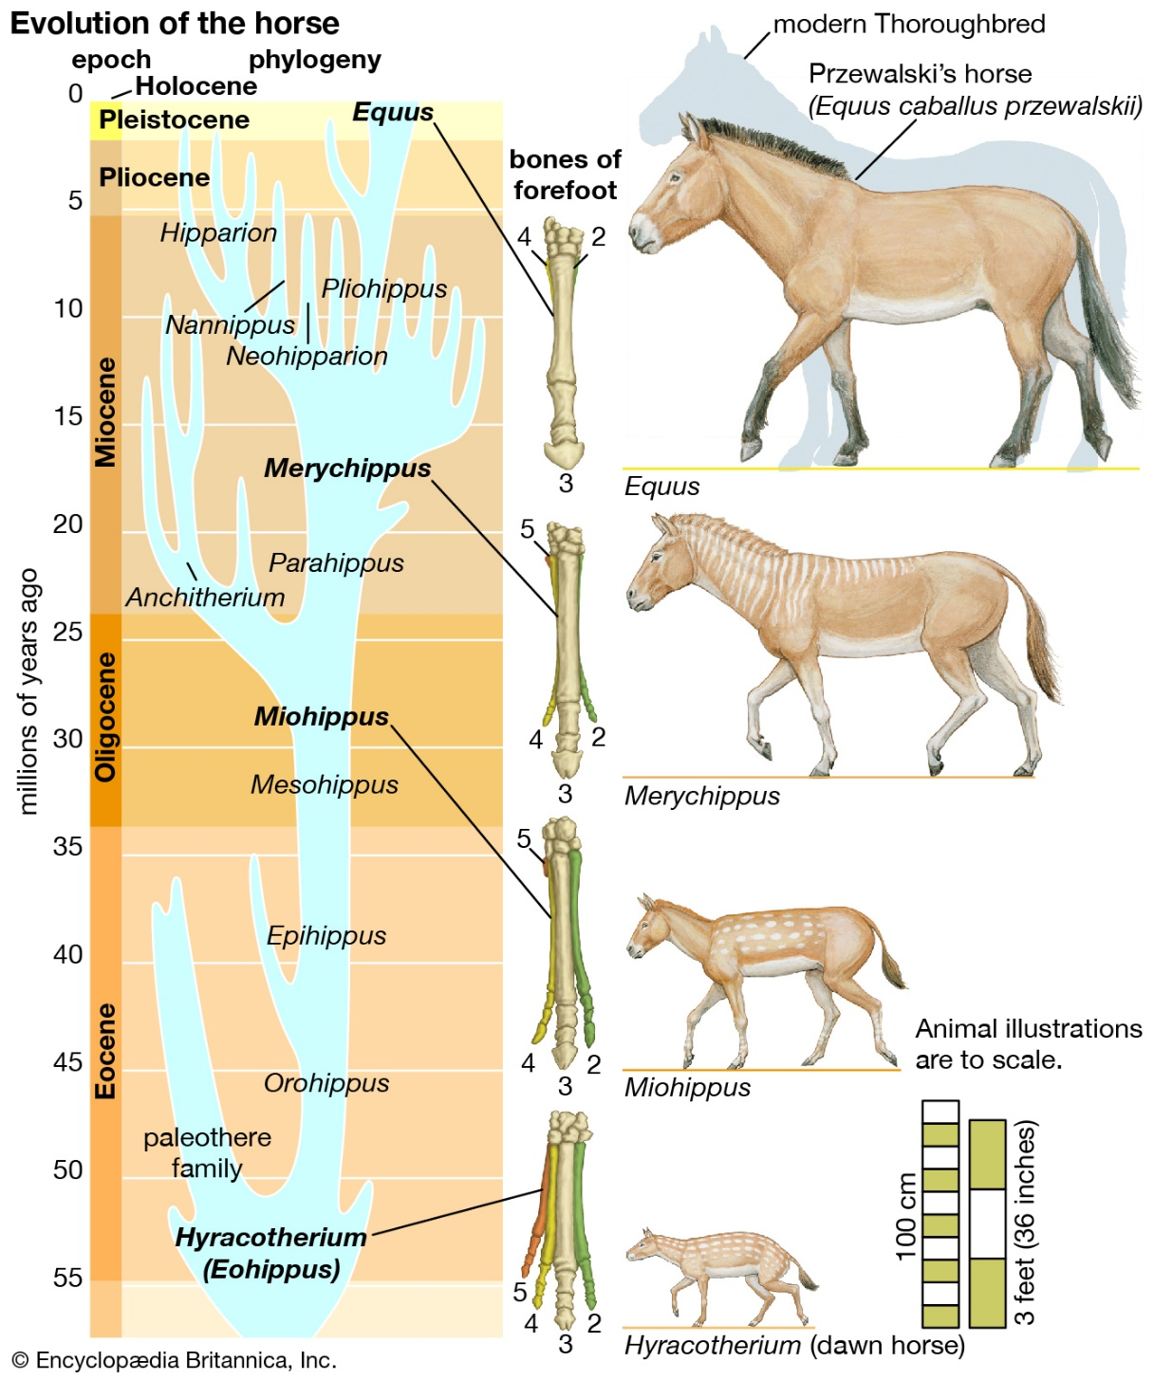
Topic Question 4: What evidence of evolution do fossils provide?
Classic Fossil Examples pg 264 – 265 Biology WA ATAR Units 3 & 4)
The Archaeopteryx was a small flying dinosaur with feathers.
It appeared in the late Jurassic period.
It shared features in common with both birds and reptiles, suggesting that birds evolved from reptiles.
Its reptile-like features include a long-tail, claws, no keel, solid bones, and teeth.
Its bird-like features include a wish-bone, feathers and reduced fingers. Intermediate states such as Archaeopteryx are called transitional forms.
The length of the limbs of the horse family has increased through time.

Slide 14
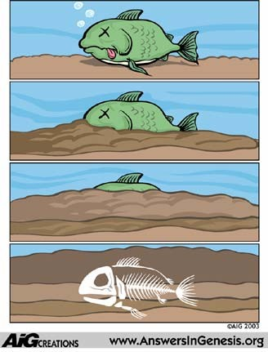
Topic Question 5: Describe how fossils are formed
Organic matter quickly deposited and covered in sediments in an environment that lacks oxygen, preventing decomposition
Organisms covered with sedimentary materials (e.g. mud); materials consolidate to form sedimentary rock
Minerals from sediments replace the natural bone/shell material, hardening the fossil
Long period of time

Slide 15
Topic Question 6: What is the fossil record?
It is the history of life as documented by fossils, the remains or imprints of organisms from earlier geological periods preserved in sedimentary rock. (https://www.britannica.com/science/fossil-record)
The fossil record helps paleontologists, archaeologists, and geologists place important events and species in the appropriate geologic era.
It is based on the Law of Superposition which states that in undisturbed rock sequences the bottom layers are older than the top layers. (https://www.nationalgeographic.org/topics/resource-library-fossil-record/?q=&page=1&per_page=25)

Slide 16
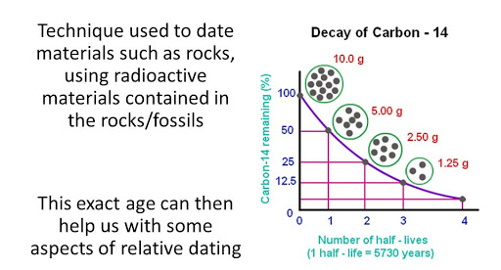
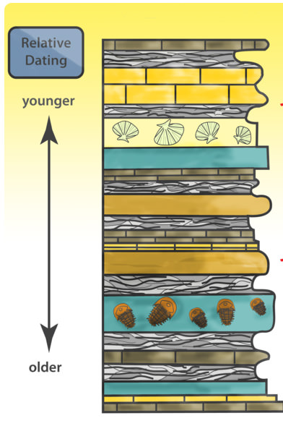
Topic Question 7: Explain how fossils are dated?
Relative dating | Absolute dating
.

Slide 17
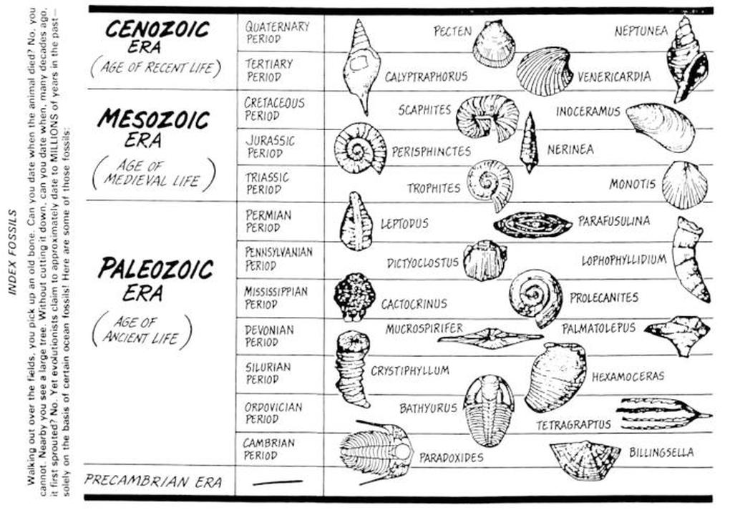
Topic Question 7: Explain how fossils are dated?

Slide 18
Topic Question 8: Explain why the fossil record is incomplete

